Slide 1
WSN@work Peter Van Aken

Slide 2
Topics
Building nodes
Exploring sensors/actuator
Learning RF/electronics
Writing firmware
Configuring controller
Building gateway
Use cases
Demo
Building

Slide 3
Platforms
Arduino (UNO, Nano, Pro mini, Mega…)
ESP8266 (ESP-3/12/…)
Raspberry Pi, BeagleBone black
…

Slide 4
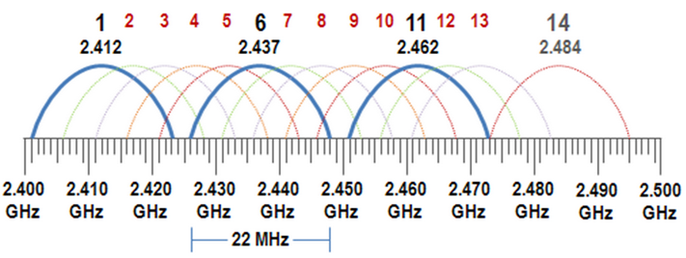

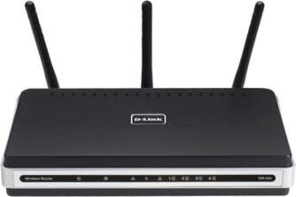
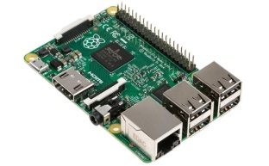
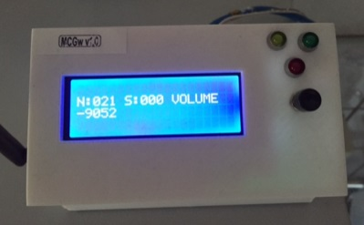


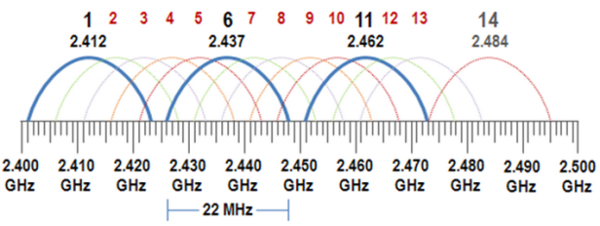
WSN@Work topology
http(s)://192.168.0.107
(wsn / 1234)
Open SSID : WSNatWork
Wifi : auto channel
(192.168.0.1)
LAN
192.168.0.x
Controller
MQTT client Gateway
(192.168.0.225)
Sensor / Actuator node
(192.168.0.107)
Repeater node
ISM (Industrial Scientific Medical) license-free band
Channel 76
selfhealing
meshing
w/battery powered
(2.476Ghz)
Wireless Sensor Network

Slide 5
Learning Arduino ?
USB book stick
Jeremy Blum : “arduino tutorial series” (https://www.youtube.com/watch?v=fCxzA9_kg6s)
Information source : https://www.arduino.cc/
Workshops ☺

Slide 6
ATMEL Atmega328p versus Arduino UNO
Wh at is an “Arduino UNO” :
Cheap open source fast prototyping platform
Based on Atmega328p + USB/serial + power
Arduino IDE
Arduino variants :
Mega, Micro PRO, Nano, … (see boards : Arduino IDE)

Slide 7
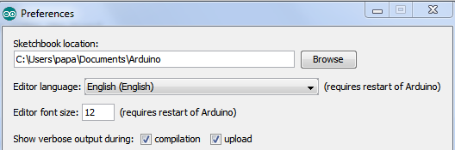
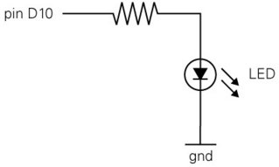
Arduino IDE
Installation :
Windows : https://www.arduino.cc/en/Guide/Windows
MaxOS : https://www.arduino.cc/en/Guide/MacOSX
Linux : http://playground.arduino.cc/Learning/Linux
Examples : “blinking Led”
Connect your LED to pin 2 & change code
2

Slide 8
Arduino IDE alternative
AVR studio

Slide 9
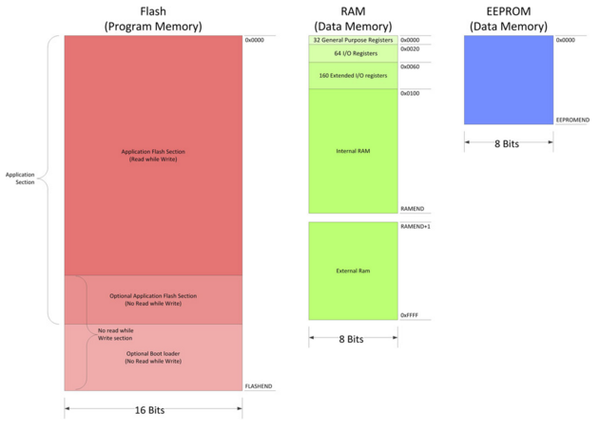
ATMEL Atmega328p
Datasheet : http://www.atmel.com/images/atmel-8271-8-bit-avr-microcontroller-atmega48a-48pa-88a-88pa-168a-168pa-328-328p_datasheet_complete.pdf
Memory map : 32KB flash 2KB RAM 1KB EEprom

Slide 10
Arduino Programming
In system programming (ISP)
Serial bootloader (Optiboot/…)
Note : powered USB hub = extra protection
OTA bootloader
MysBootloader
DualOptiboot

Slide 11
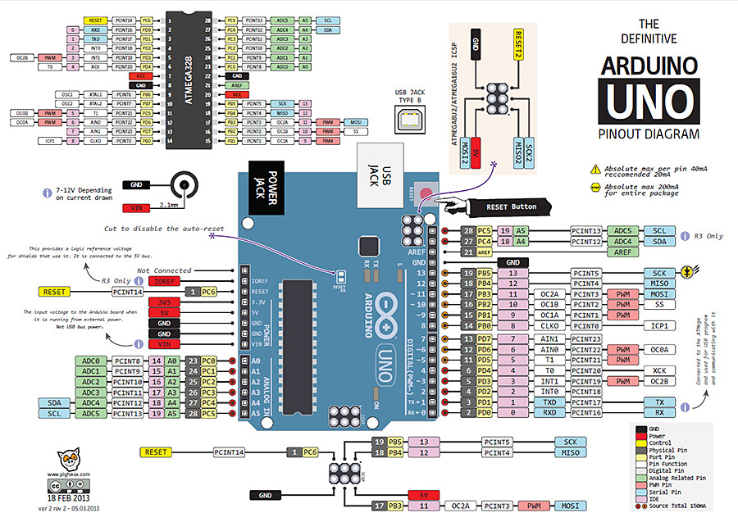
Arduino UNO reference https://arduino-info.wikispaces.com/QuickRef

Slide 12
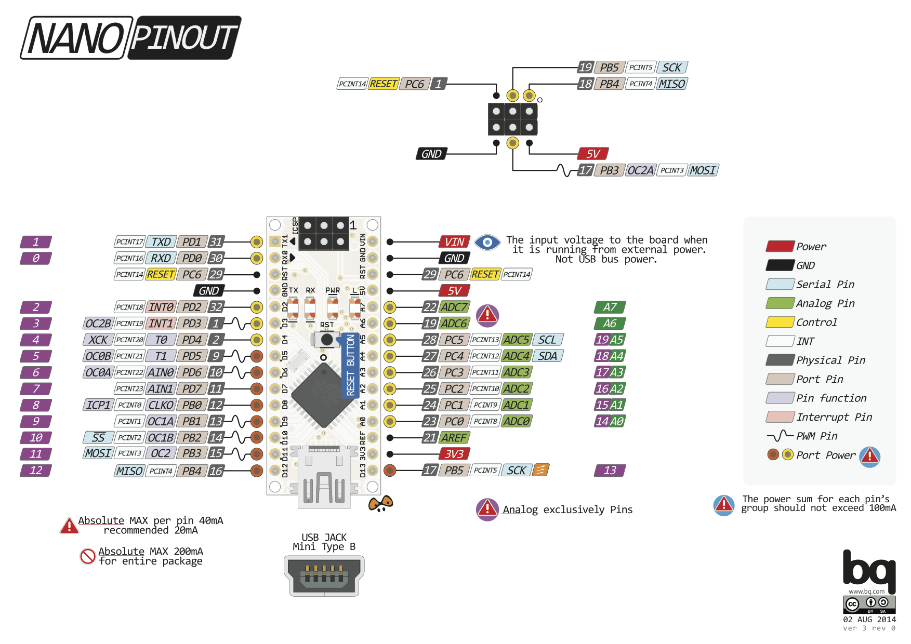
Arduino NANO reference

Slide 13
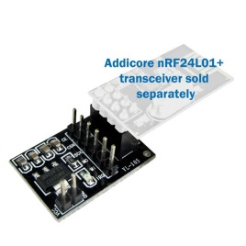
“The Radio” : Nordic NRF24L01+
Datasheet : http://www.nordicsemi.com/eng/Products/2.4GHz-RF/nRF24L01P
Highlights :
2.4Ghz – 2.525Ghz : stay out Wifi band !
250 kbps (only+!), 1Mbps, 2Mbps
Low power : 1.9 – 3.6v, I/Os 5V tolerant
Breakout/adaptor : 3.3v - 12V
Vcc filter capacitor

Slide 14
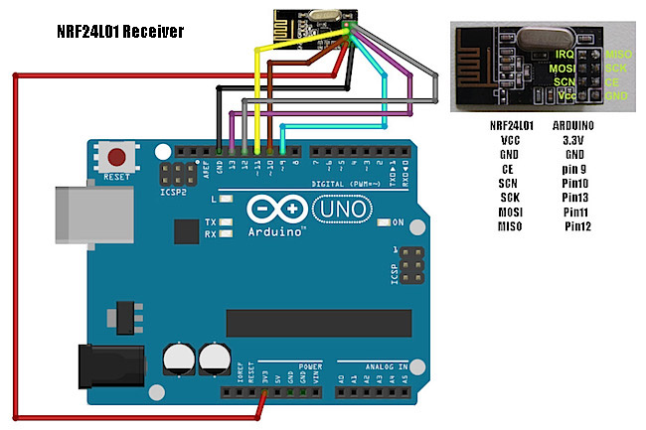
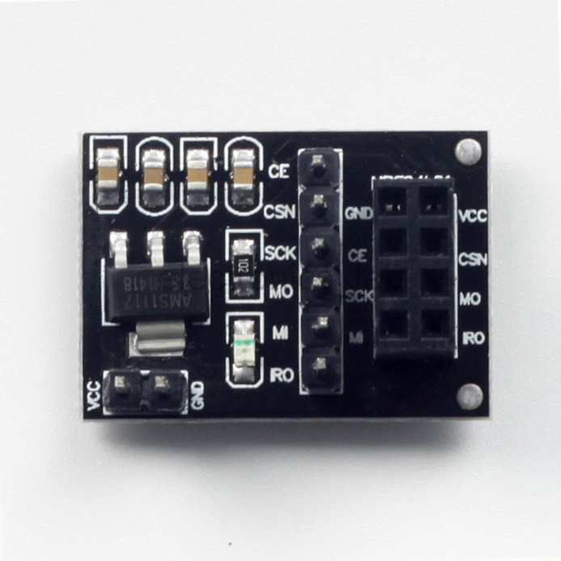
Wiring NRF to UNO (SPI interface)

Slide 15
Wiring NRF with breakout board
Breakout Uno Nano
Vcc 5V 5V
Gnd Gnd Gnd
CE 9 (PB1) 9 (PB1)
SCN 10 (PB2) SS 10 (PB2) SS
SCK 13 (PB5) SCK 13 (PB5) SCK
MO 11 (PB3) MOSI 11 (PB3) MOSI
MI 12 (PB4) MISO 12 (PB4) MISO

Slide 16
Node firmware : MySensors
http://www.mysensors.org/
Download :
Mysensors v1.5 : http://www.mysensors.org/download/
“node test”
MyConfig.h
Code walk
Change NodeId & go

